Slide 1

AL MUSTAFA TRUST
We provide primary health care free of cost to the poor and needy people throughout Pakistan

Slide 2
Mission and Objectives

Slide 3
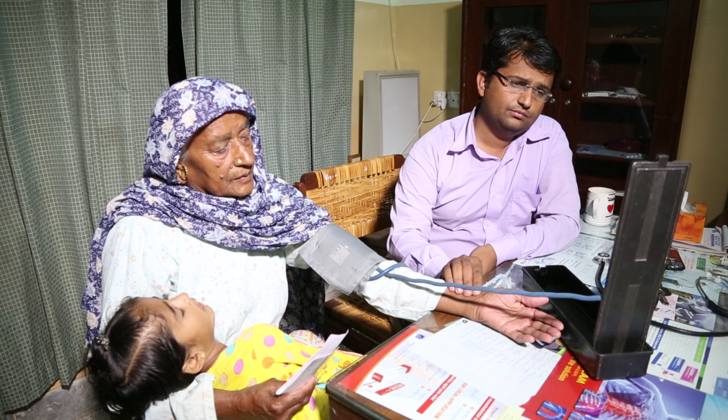
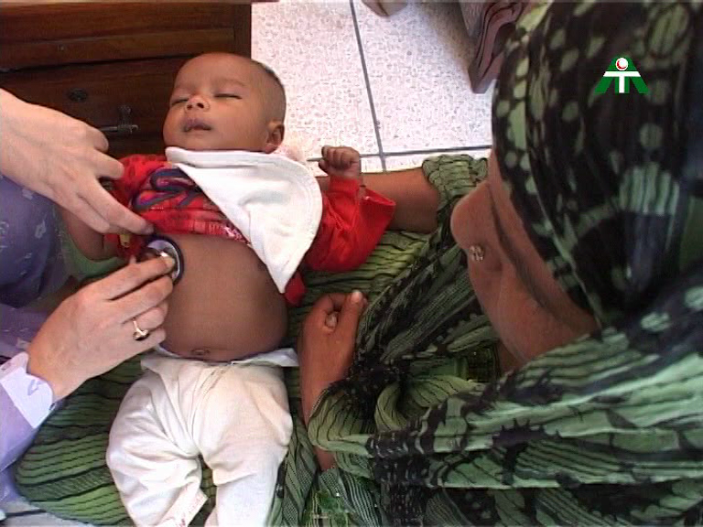
Mission
Provide primary health care free of cost, to the poor and needy people and at considerably reduced rates to those who can afford to pay.

Slide 4
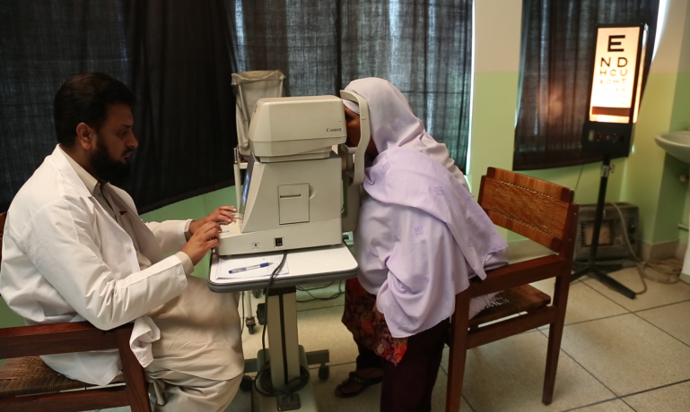
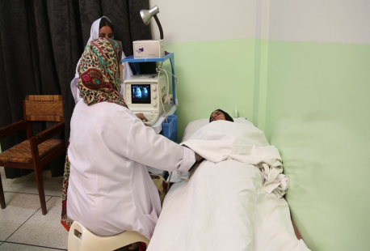
Objectives
  Establish Medical Centers, Dispensaries and Mobile Dispensaries for effective primary medical care of poor and needy people, in poor localities of Urban and Rural areas with special emphasis on rural areas of Pakistan.

Slide 5
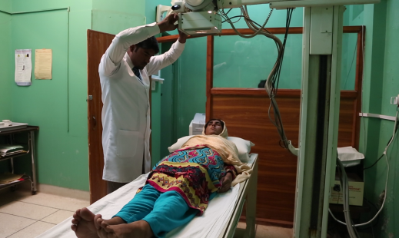
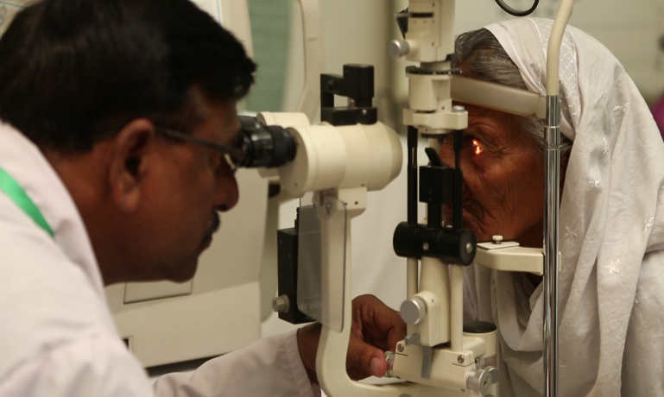
Objectives
  Arrange free specialist medical consultancy to patients through specialists of repute where possible.
  Provide medicines and required diagnostic facilities (Pathology Laboratory, X-Ray, ECG, Ultra Sound, etc.)

Slide 6
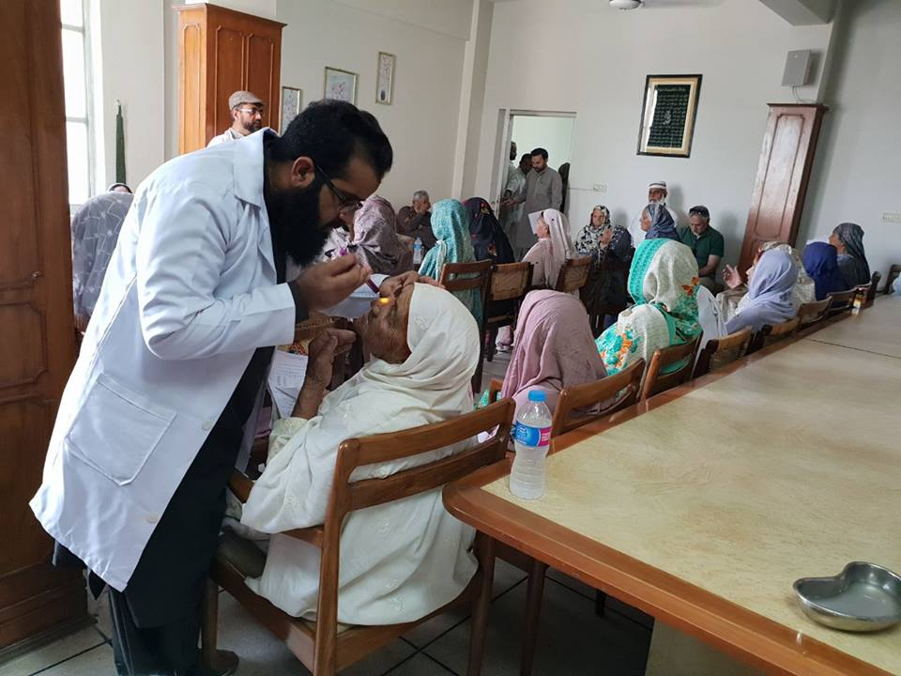
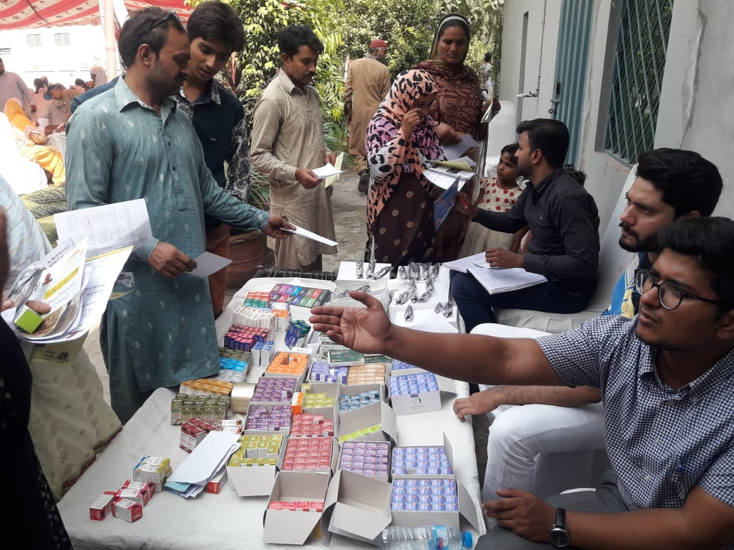
Objectives
Arrange health awareness programs for prevention and control of diseases, especially in the poor localities.
Reach out to patients of far flung areas through mobile dispensaries and organizing Medical Camps.

Slide 7
Financial Control
Audit by KPMG, BDO Ebrahim and Ameer Alam Khan & Co, Chartered Accountants.
Audit in UK by King & King & Morgan Reach Chartered Accountants.
Income Tax Exemption for Donations.
Minimum Staff.
Senior Management – All Volunteers.

Slide 8
Al Mustafa Charitable Trust UK
King & King Chartered Accountant
Extract from Report of the Trust
7. Employees
“No salaries or wages have been paid to employees, including the Trustees, during the year”

Slide 9
Integrated Network of Al-Mustafa Trust
Medical Centre
Medical Centre
Medical Centre
Dispensary
Dispensary
Dispensary
Mob Dispensary
Mob Dispensary
Mob Dispensary
Station 1
Station 2
Station 3
Station 4
Station 5
Medical Centers 31 Dispensaries 15 Mobile Clinics 10
Under Construction 05 Mobile Clinic Station 63
Total Footprint 114 (Functional 109)

Slide 10
Performance of the Trust

Slide 11
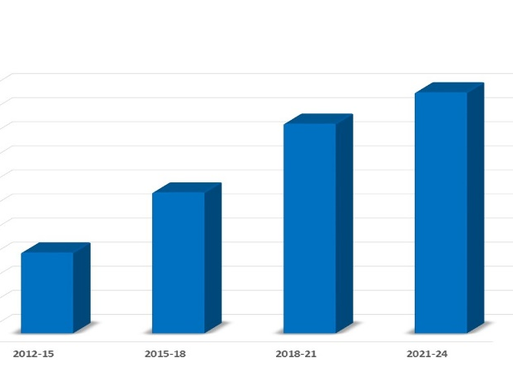
PCP Certification Report 2021-2023
Institutional Mechanisms of Oversight
Financial Management
Program Delivery
178/200
Total
89%
187/200
94%
275/300
92%
924/1000
92.4%
92.4%
89.4%
83.7%
78.7%
12-15
15-18
18-21
21-23
Overall Grading – 92.4%

Slide 12
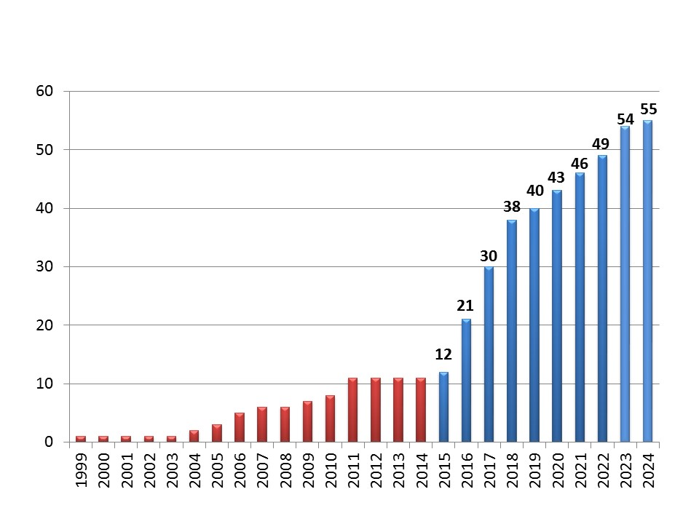

Growth of Al Mustafa Trust
(Medical Centres/Dispensaries/Mobile Clinics)

Slide 13
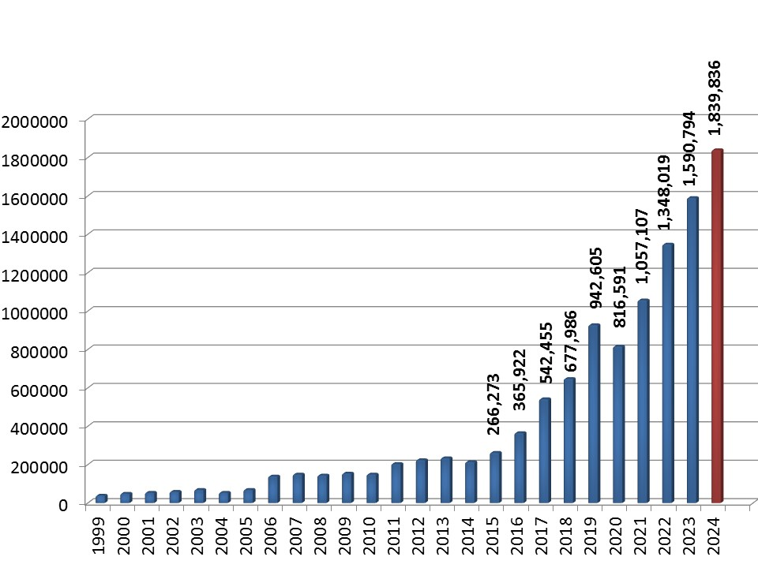
Beneficiaries
increase since 2015 over 1.6 million (597.4 %)
Total Beneficiaries over 11.1 million, Alhamdolillah

Slide 14
Computerization
&
Website

Slide 15
Computerization of the Trust
Benefits are obvious;
  Transparency,
  Patients’ records.
  Inventory Management.
  Pilferage Controlled.
  Credibility.
Because of financial constraints we could not deploy top of the line solutions but are using practicable solution, donated by a software company.
23 Medical setups computerized while 4 are in progress.

Slide 16
AMT Technological Advancements
(2019–2024)
Iqbal Nagar
Gulshan-E-Maymar
Kanyat Khalil
Khanewal
Pajjagai Peshawar
Babini Mardan
Mehran Town
DHA Lahore
Walton
Qilla Gujjar Singh
Umerkot
Korangi
Chaklala scheme III
Clifton
2019
2020
2021
2022
2023
2024
Mehmoodabad
Orangi Town
Sillanwali
Lalazar
Faisalabad
Multan
Wazirabad
Jewera
Chishtian

Slide 17
Website Development
New website has been developed by Mr Kamran Sheikh (UK) FREE OF COST.
The new site enables donations online.
Would also be accessible through all available social media applications.
Single website is operative globally by the name of;
  https://almustafatrust.charity/

Slide 18
Signature Centres
Chaklala, Rawalpindi.
Charrar Village DHA, Lahore.
Korangi, Karachi.
Chishtian (Up-gradation as Signature Centre in progress)

Slide 19
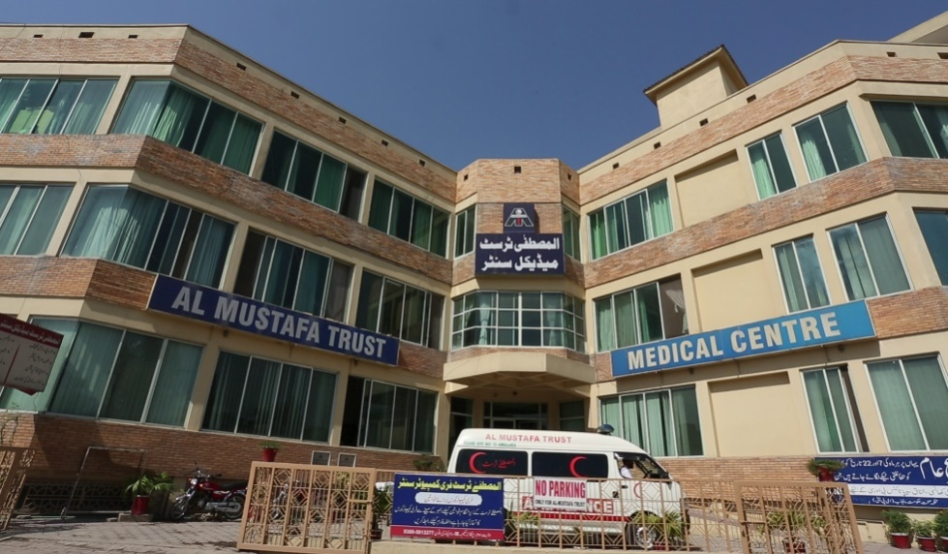
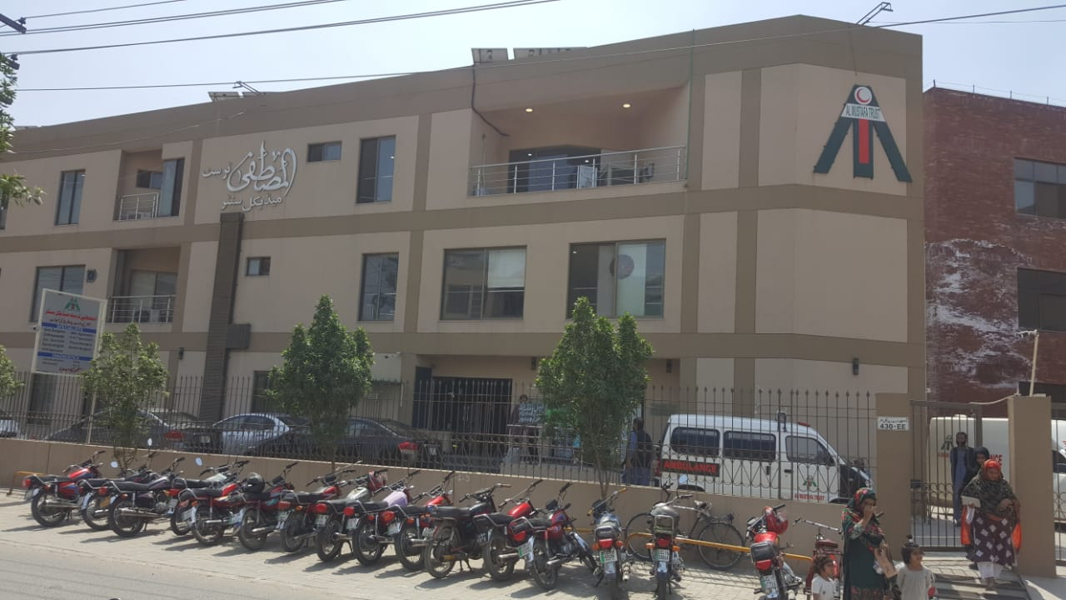
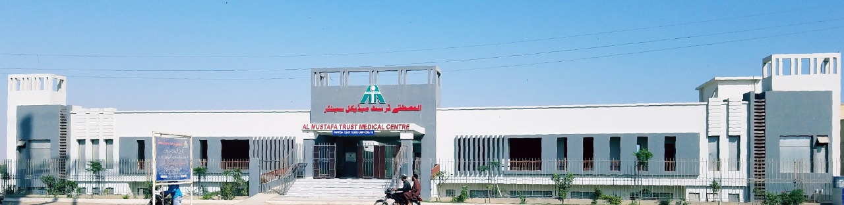
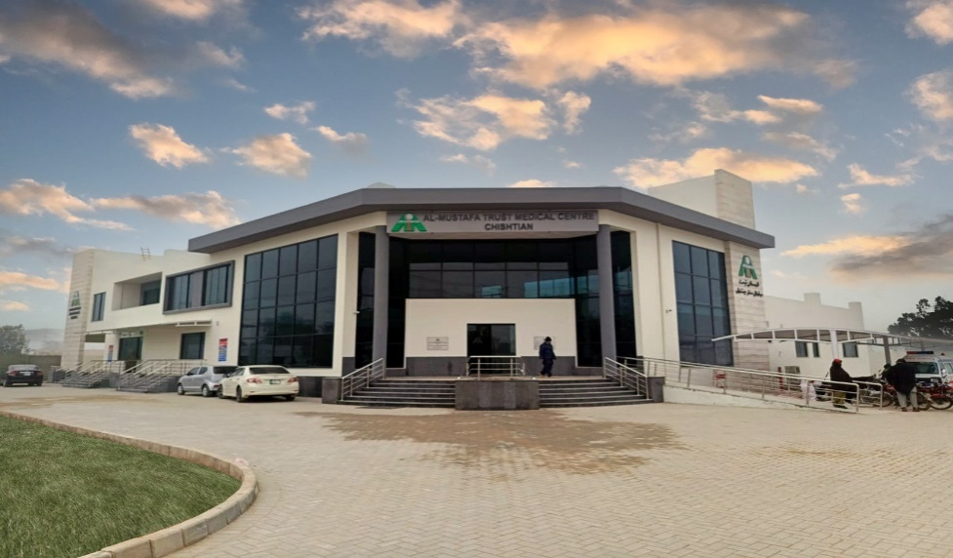
Signature Centres
Chaklala, Rawalpindi
Charrar Village DHA, Lahore
Korangi, Karachi
Chishtian (facilities being added)

Slide 20
Facilities at Signature Centers
 | Chaklala | Lahore | Karachi
Specialists | 16 | 18 | 06
General Medical Practioners | 08 | 05 | 09
Average Patients per day | Over 500 | Over 700 | Over 900
Major Specialties | Nephrologist, Gynecologist, Pathologist, Radiologist, Cardiologist, Dermatologist, Sonologist, Medical, Surgical, Pathologist, Pediatric (Child), Physiotherapist, Dentist, Gastroenterologist, Eye Specialist, Child Specialist, Orthopedics Surgeon, Skin Specialist, Psychotherapist, Psychiatrist, Pulmonologist, Neurologist, Urologist, Nutritionist

Slide 21
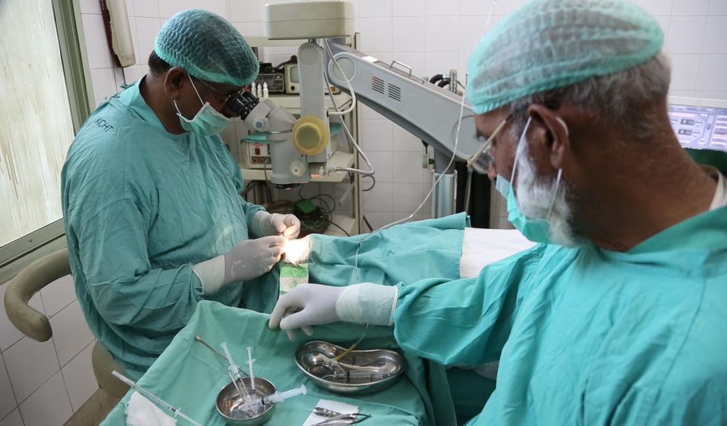
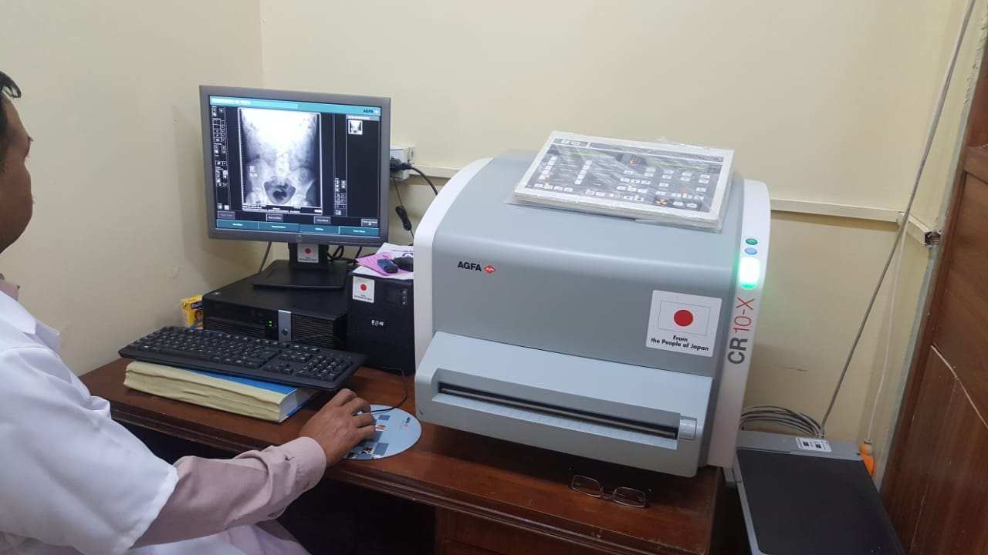
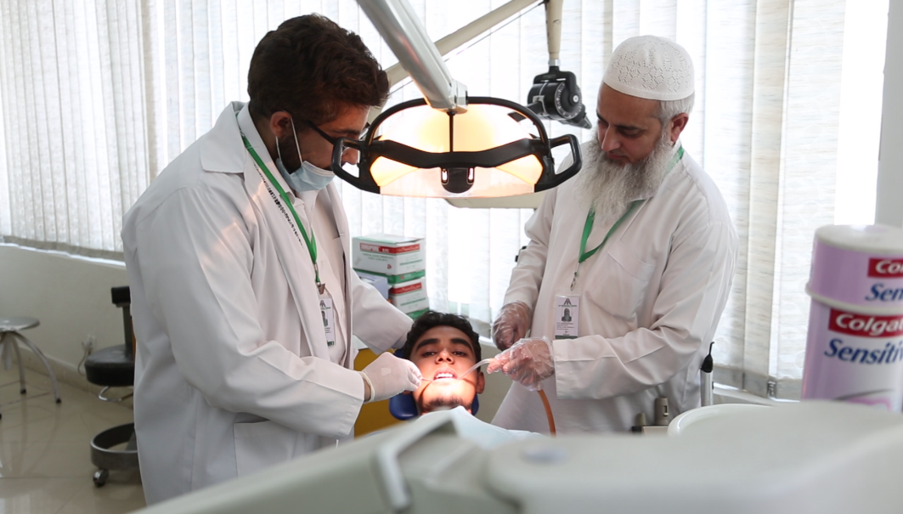
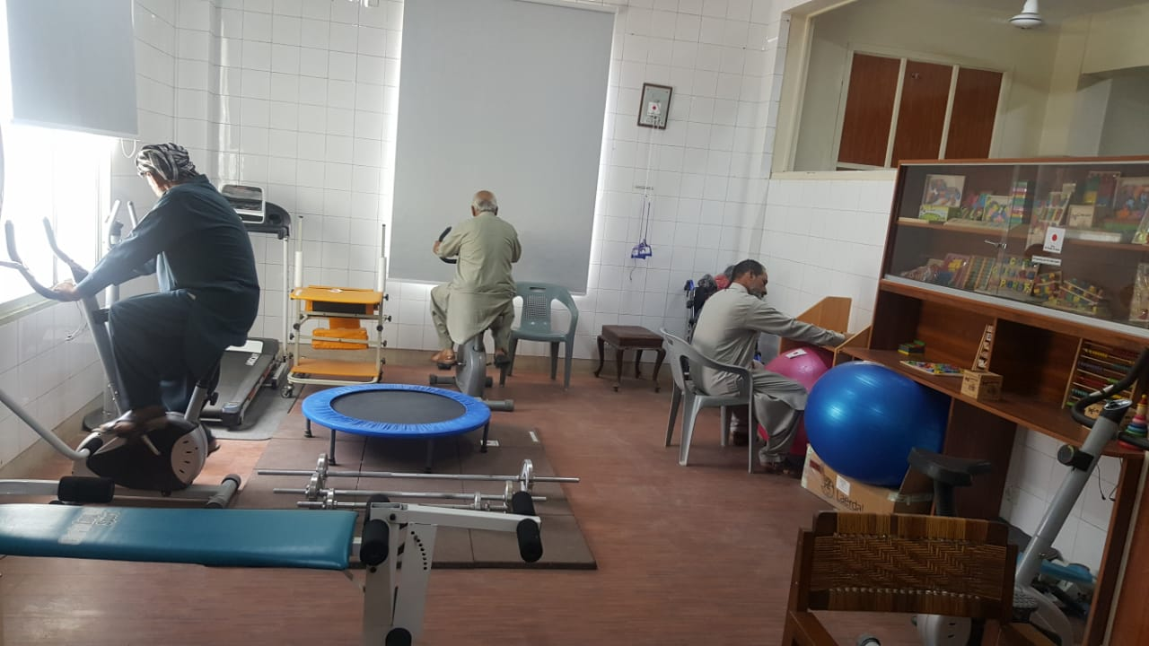
Chaklala Rawalpindi

Slide 22
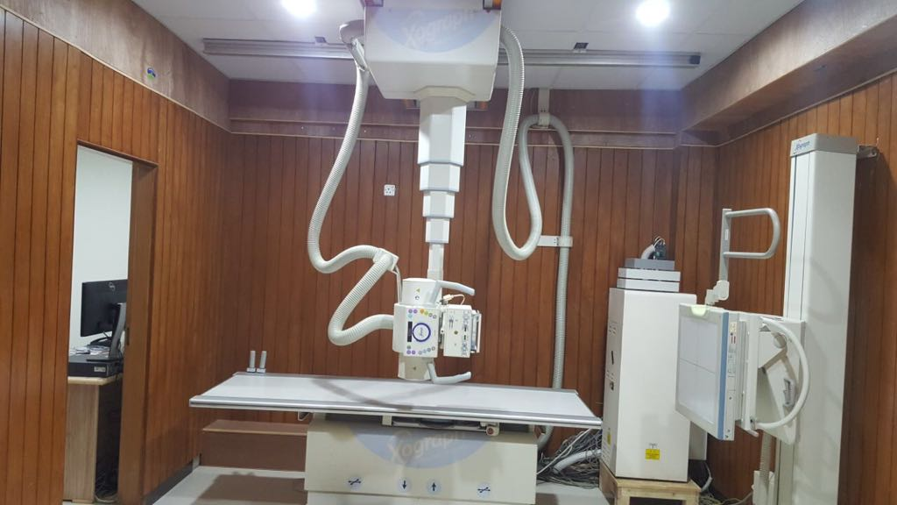
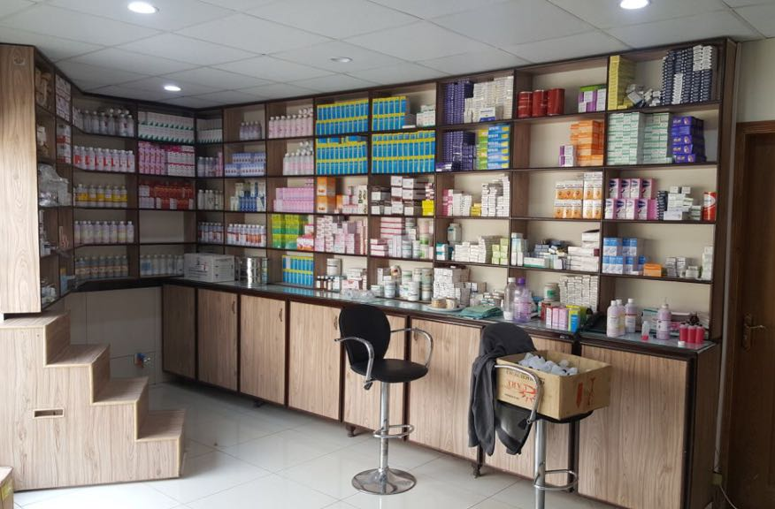
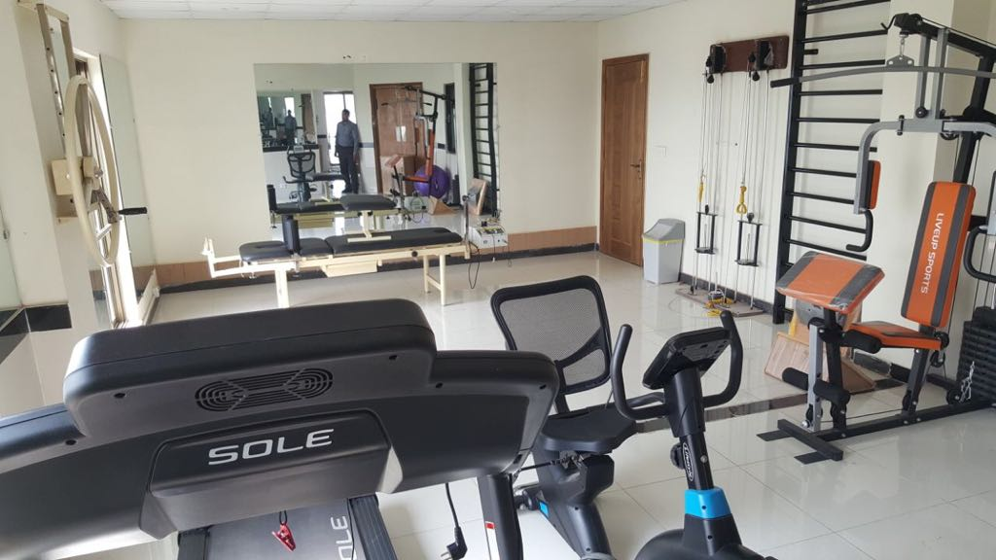
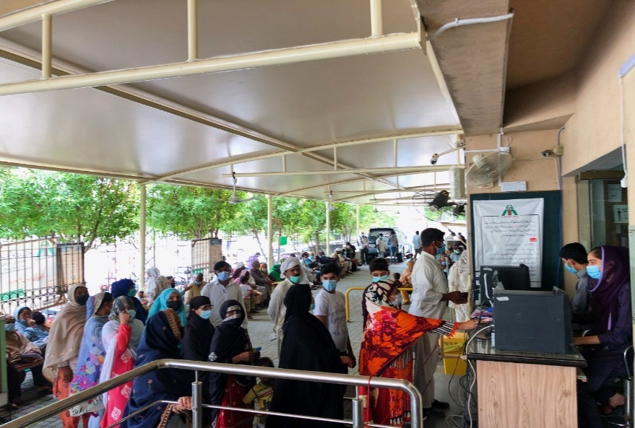
Charrar Village, DHA Lahore

Slide 23
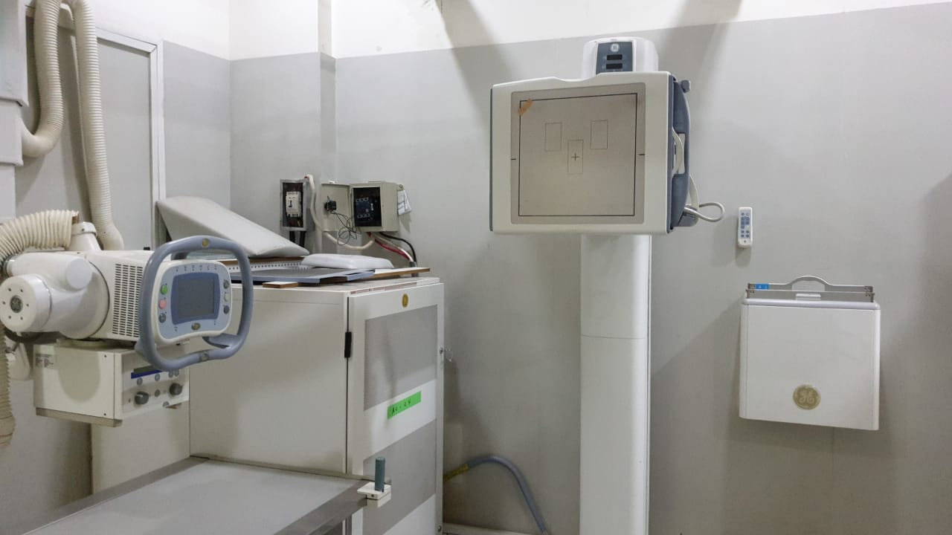
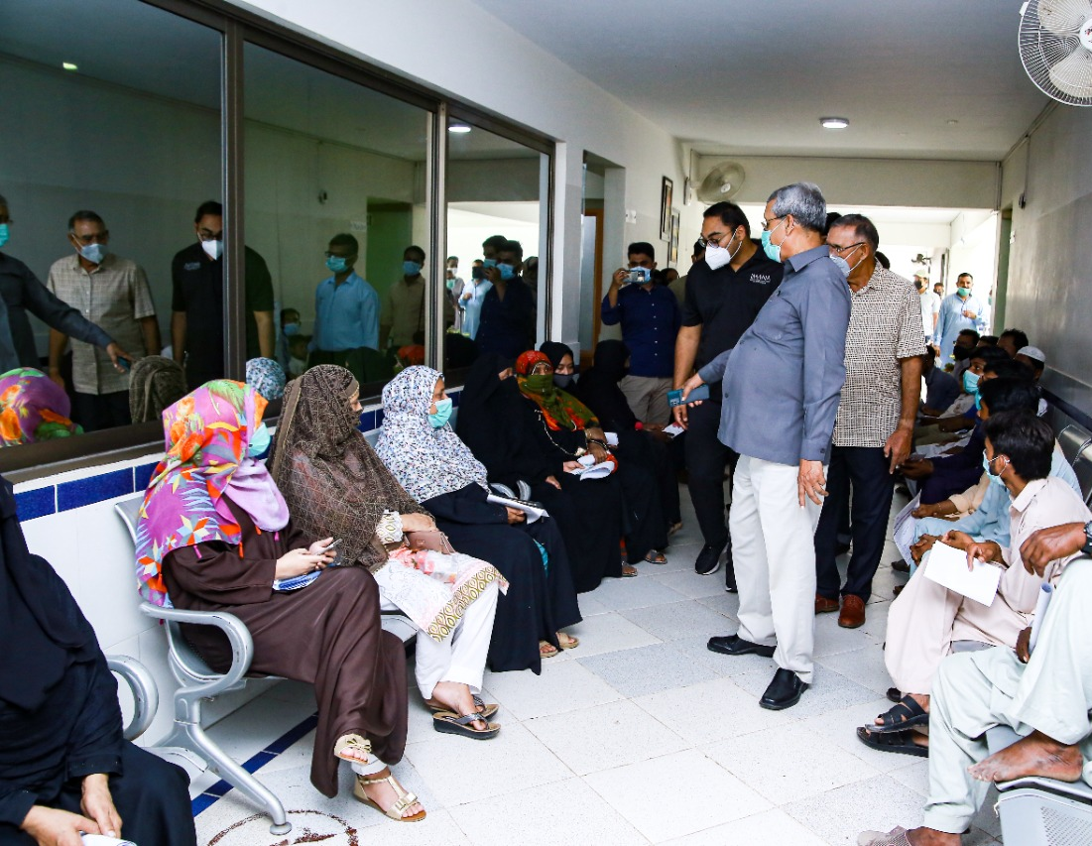
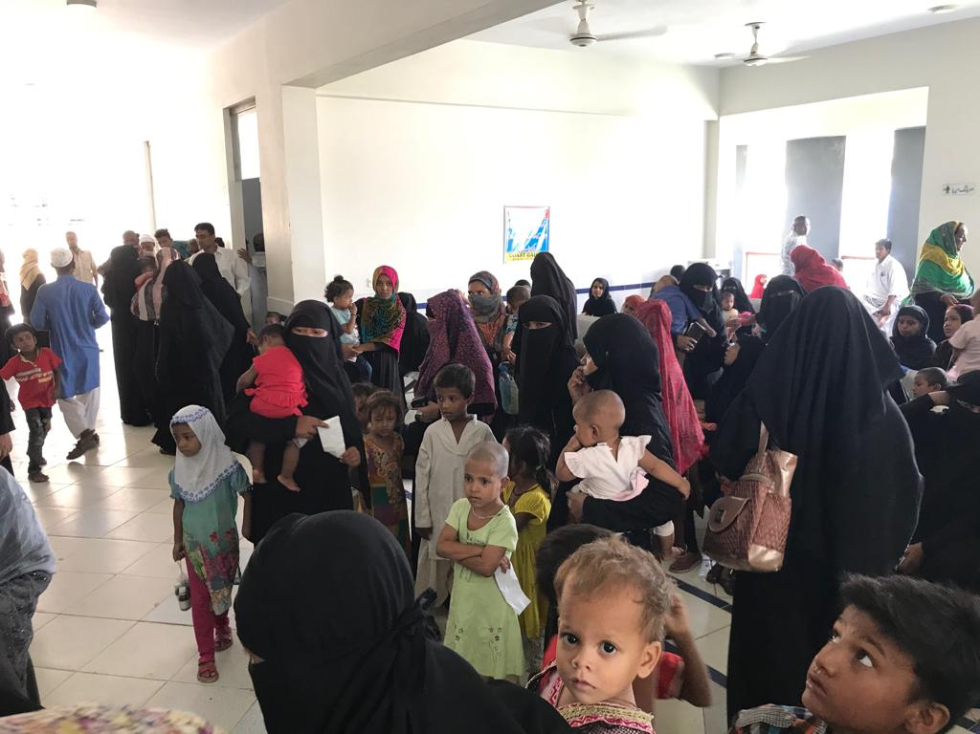
Korangi, Karachi

Slide 24
Projects Completed Since Aug 2022

Slide 25
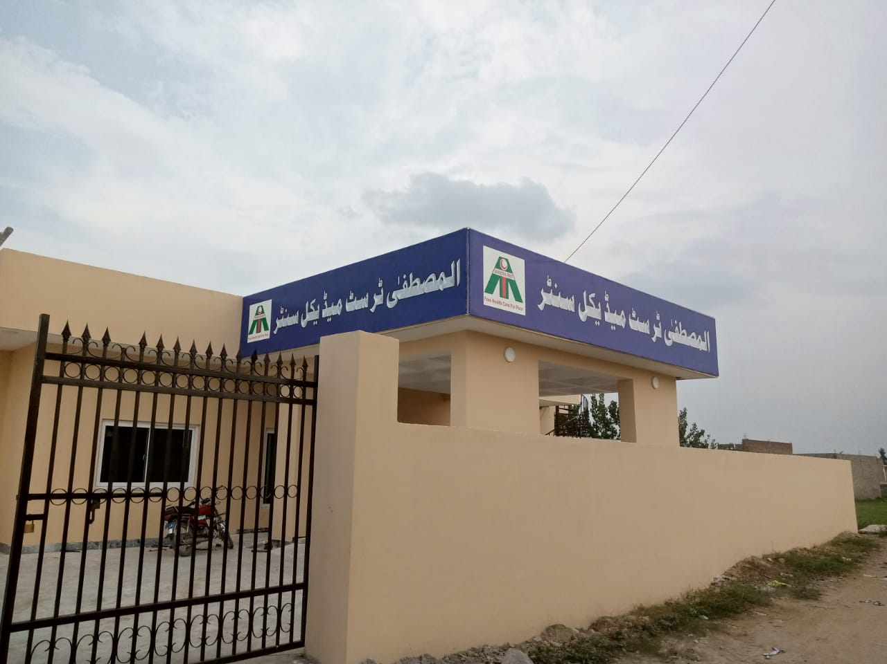
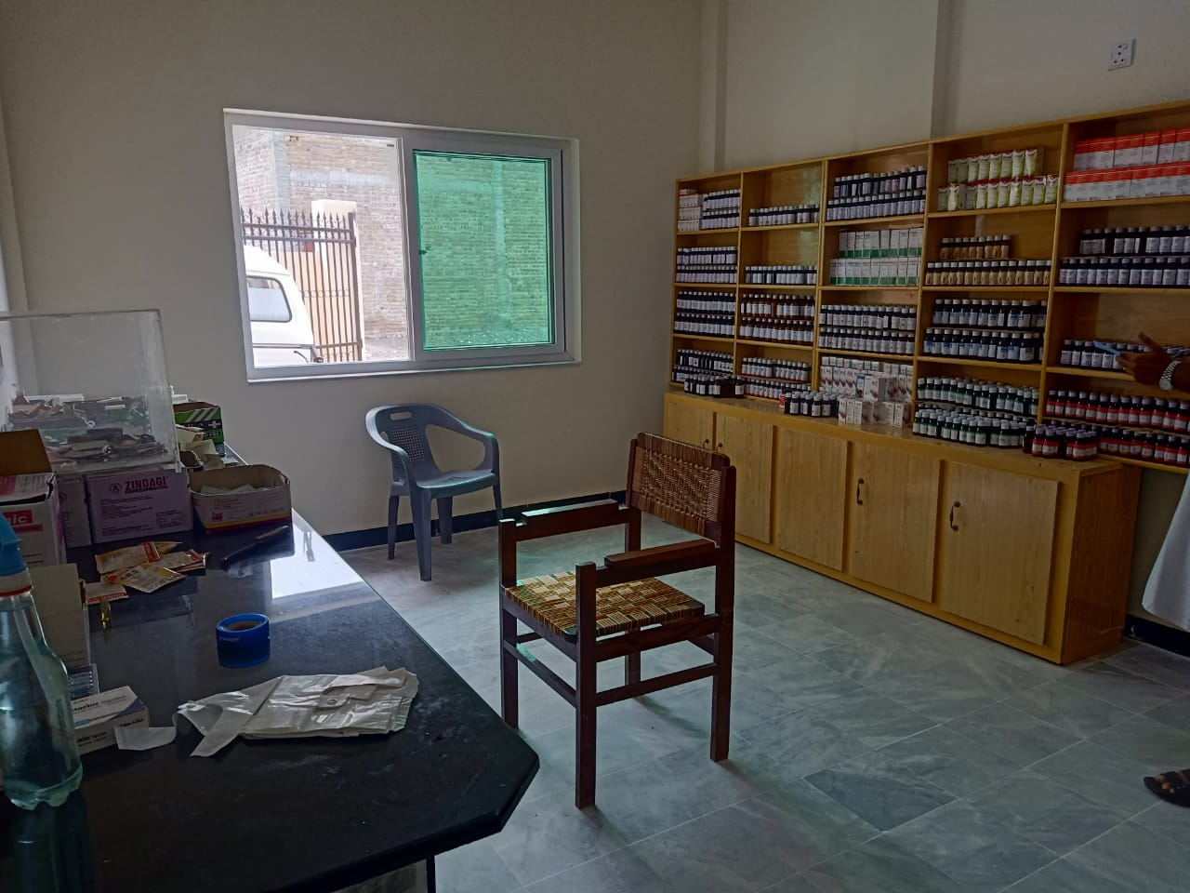
Peshawar
(15th Aug 2022)

Slide 26
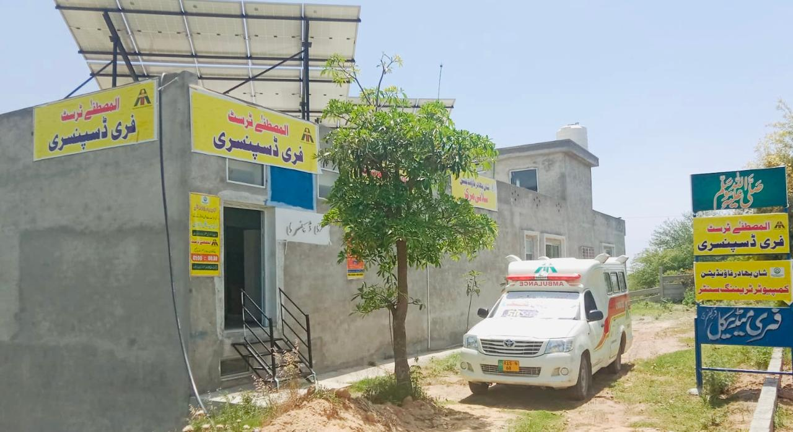
Dispensary at Rawat
(10 Feb 2023)

Slide 27
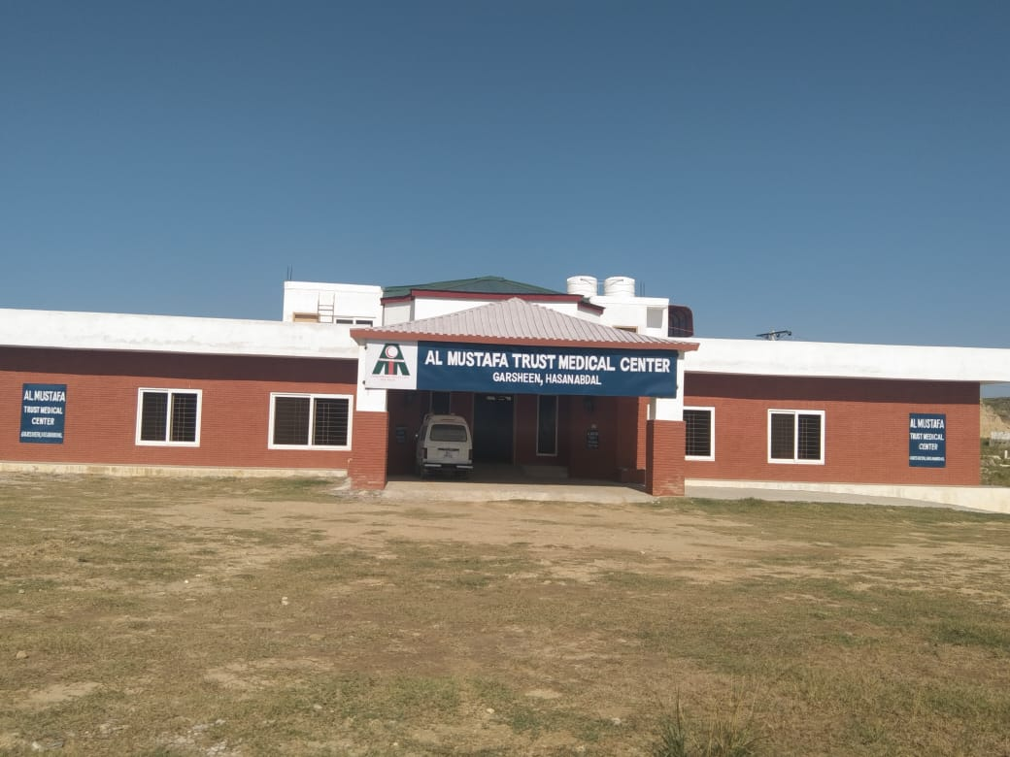
Garsheen - Hassan Abdal
(14th Feb 2023)

Slide 28
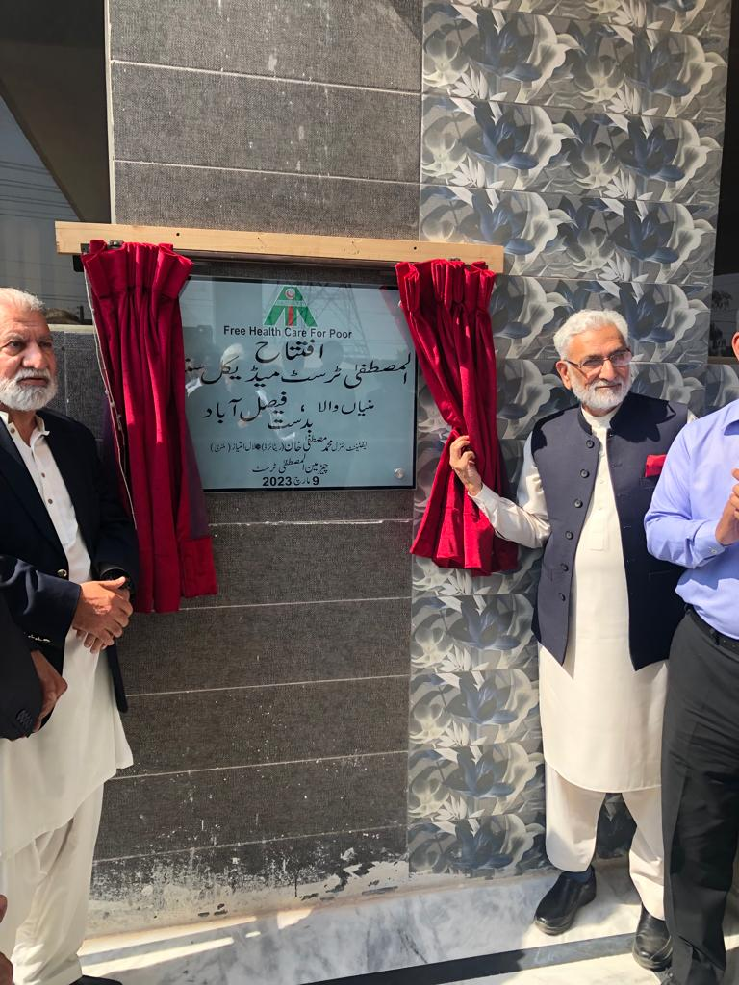
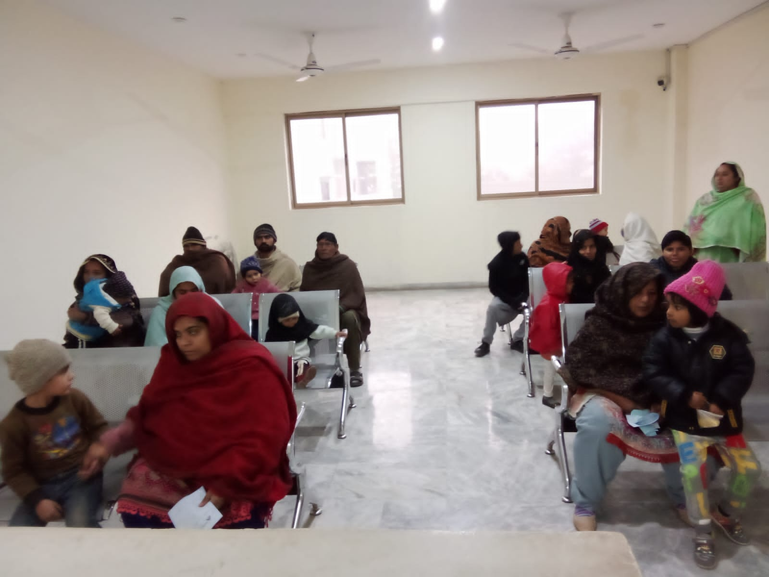
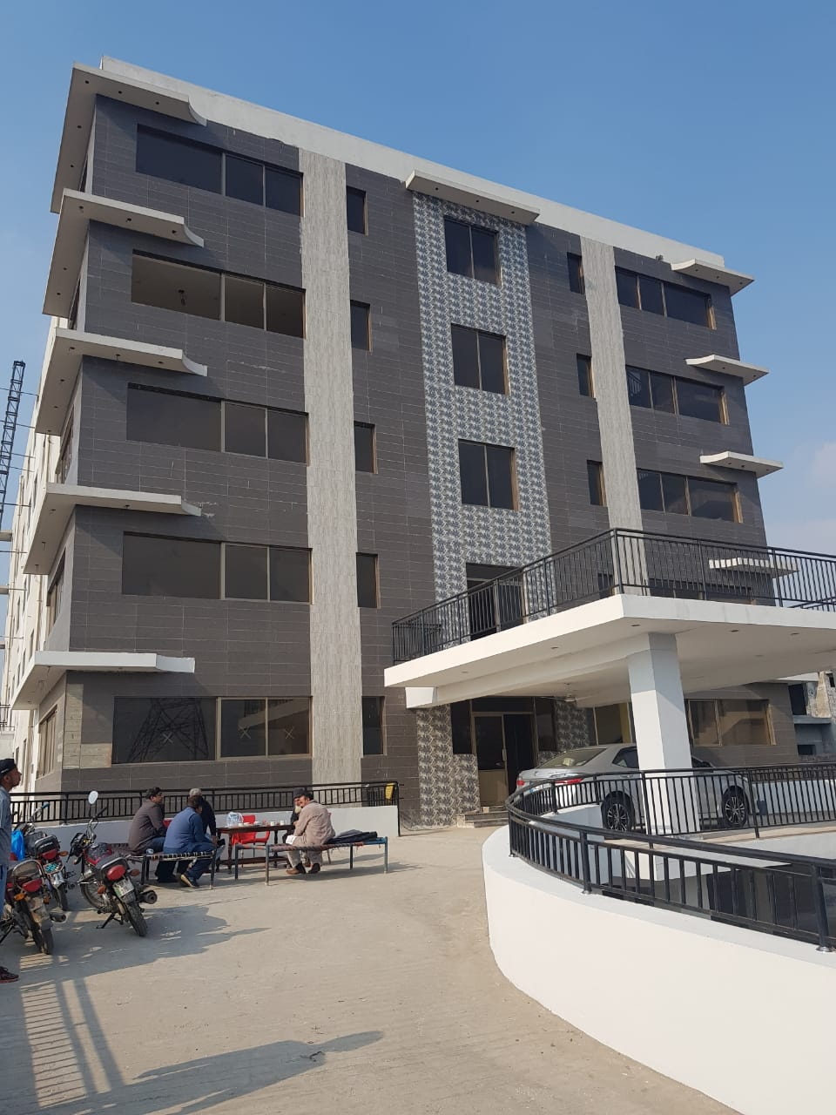
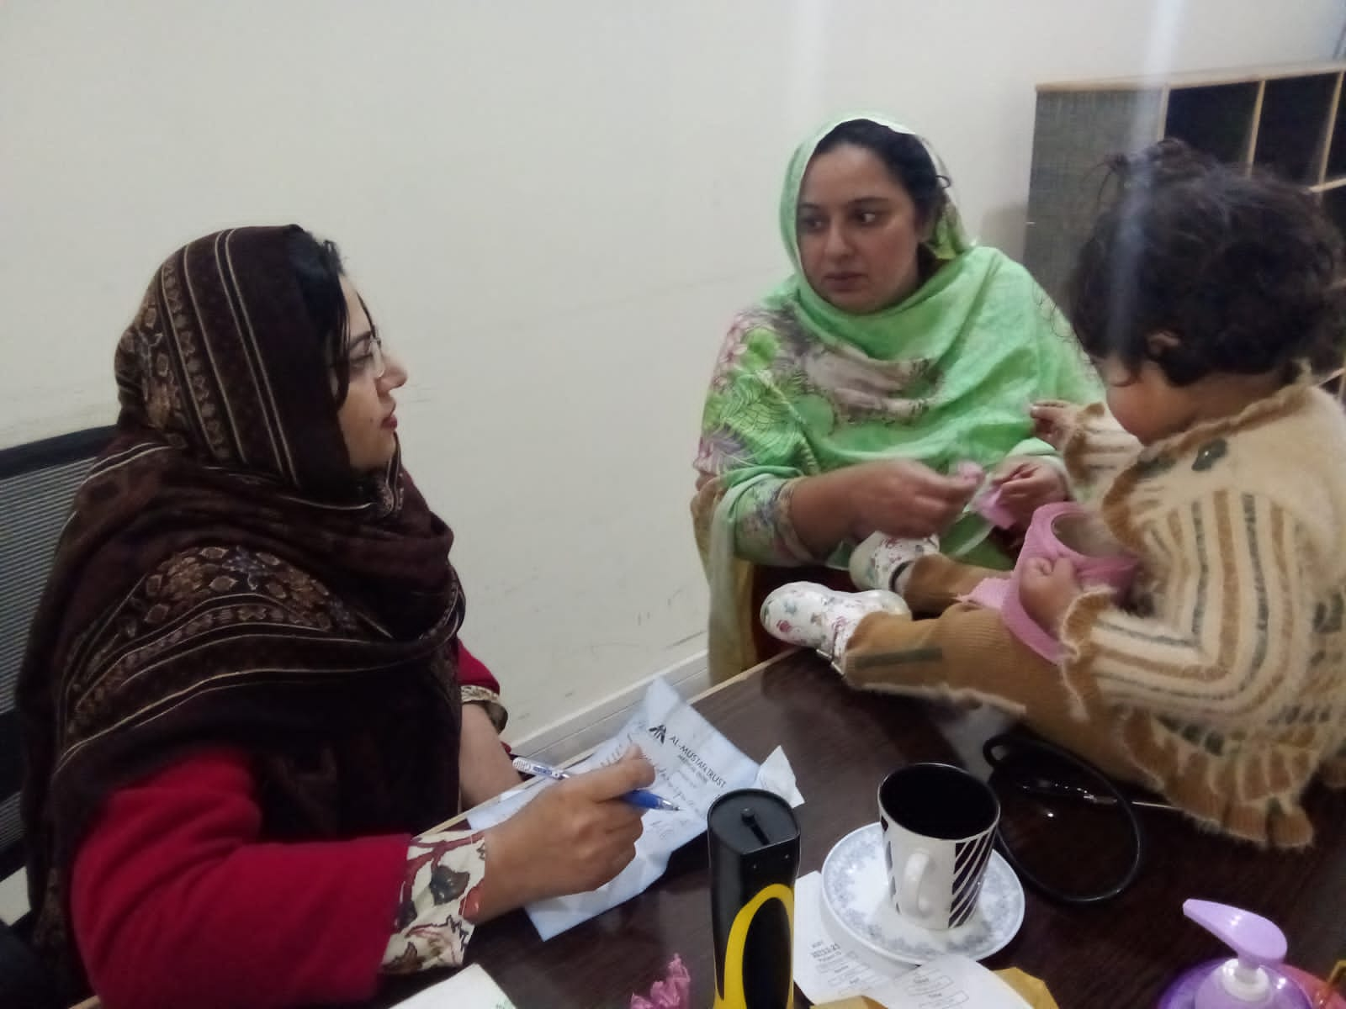
Munnianwala-Faisalabad
(9 March 2023)

Slide 29
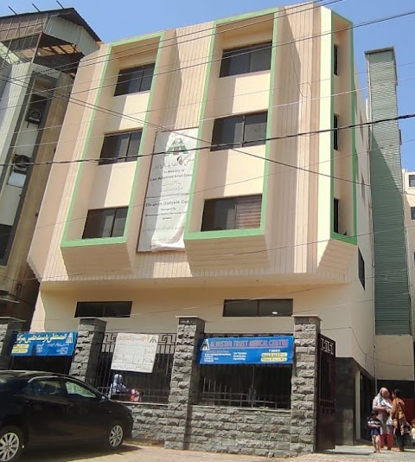
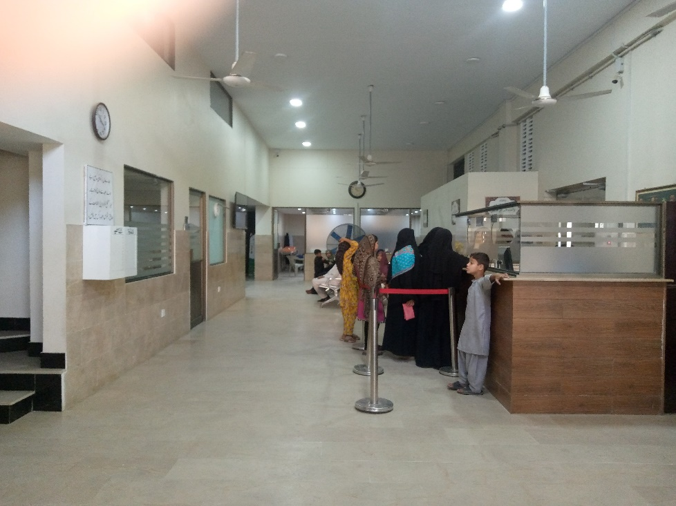
Medical Center Mehmoodabad
(Shifted to New Building on 28 Apr 23)

Slide 30
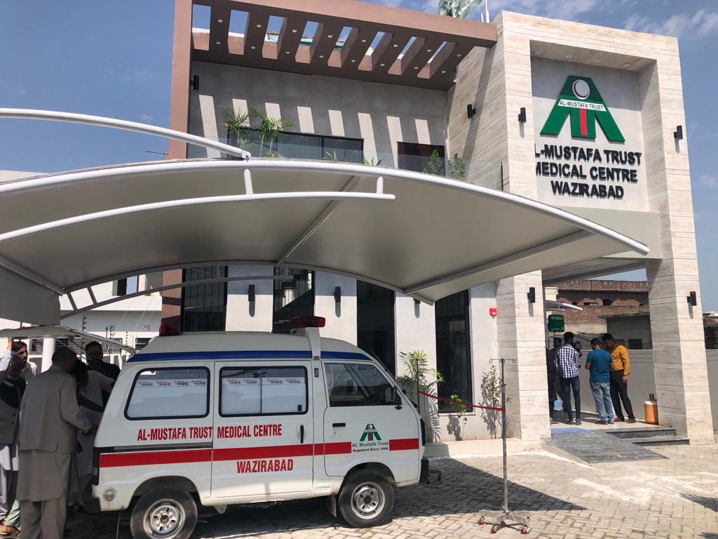
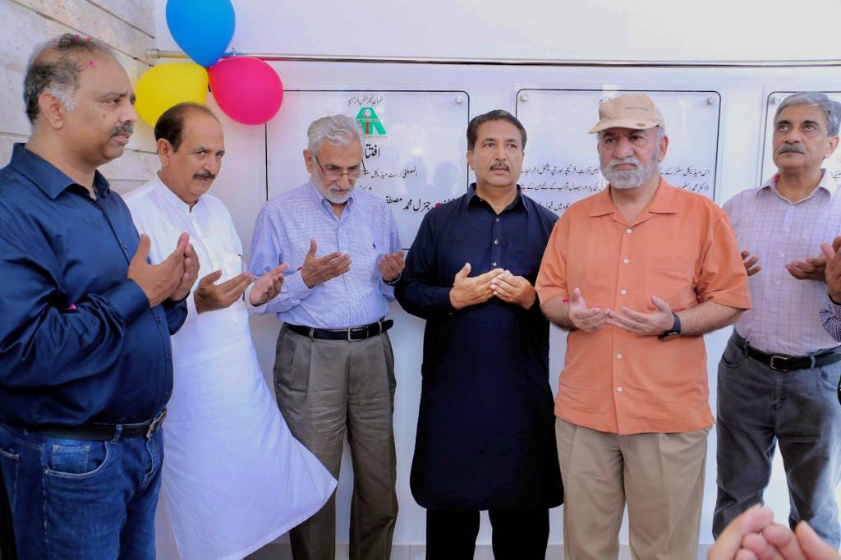
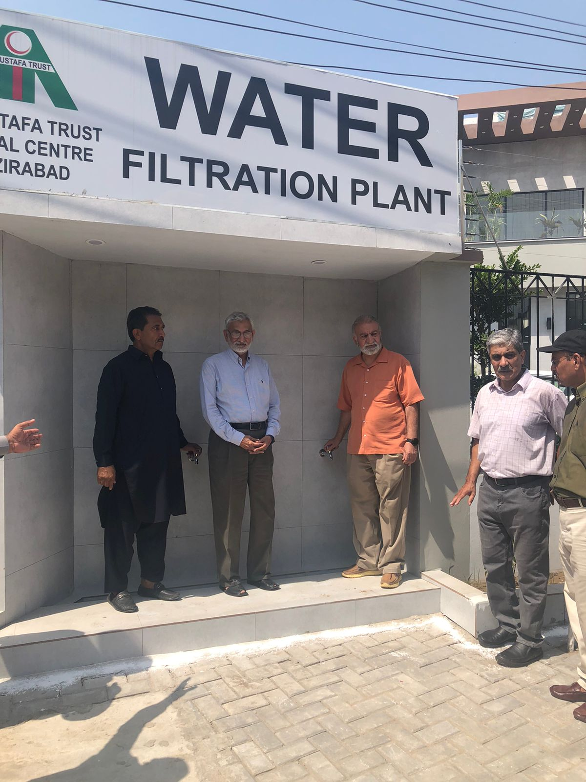
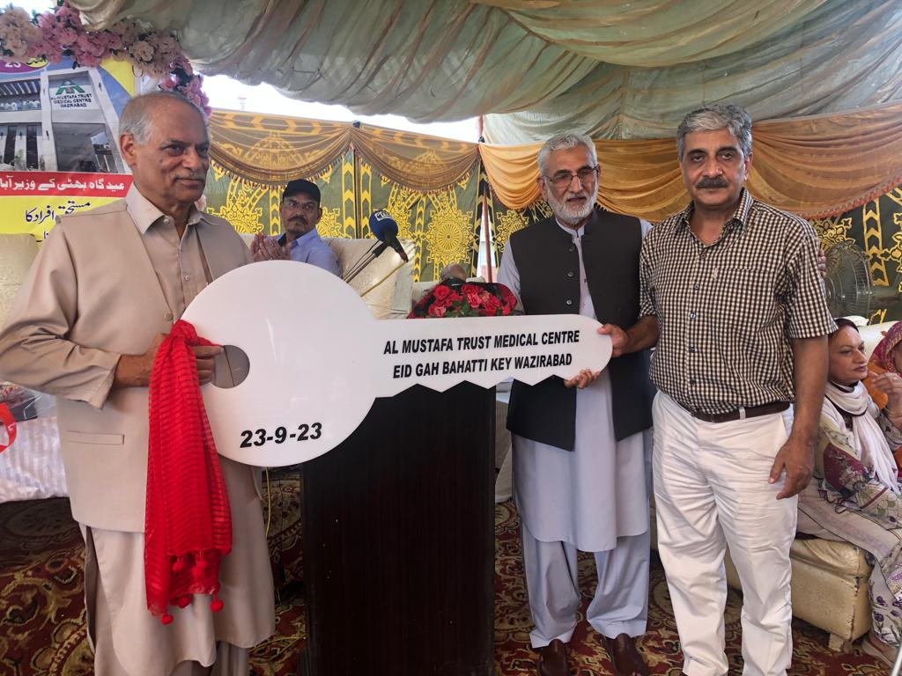
Bhatti Ke-Wazirabad
(7 September 2023)

Slide 31
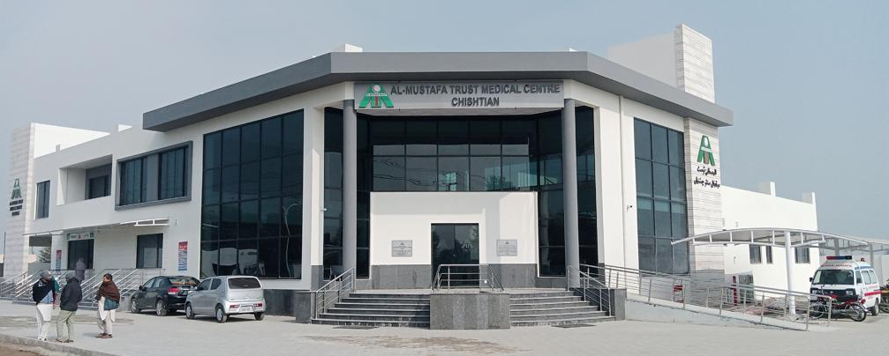
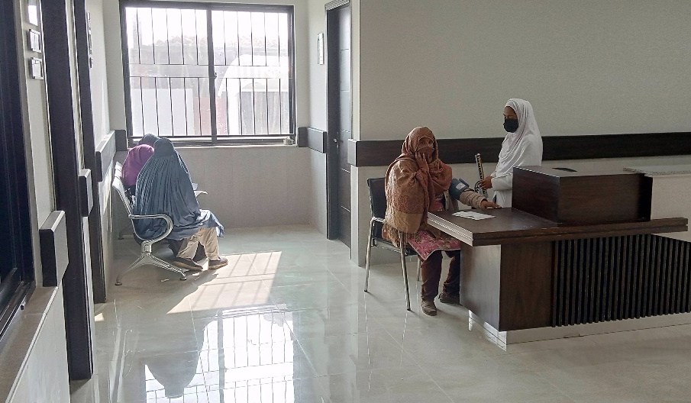
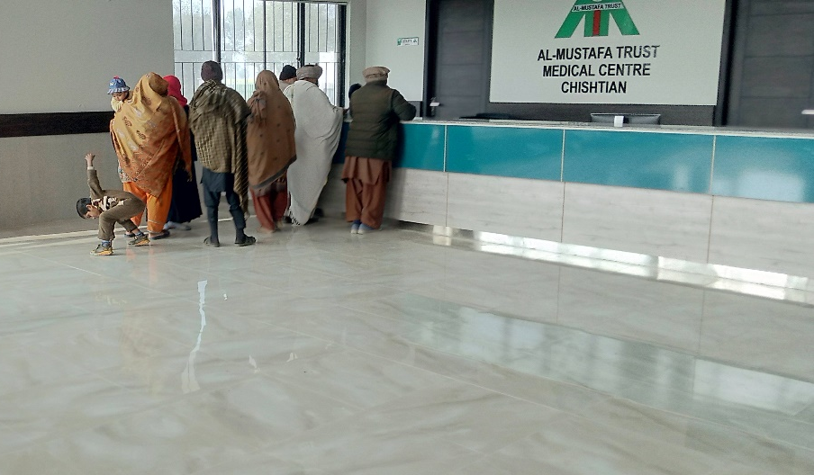
Chishtian – by Ch M. Muni (USA)
(1st Jan 2024)

Slide 32
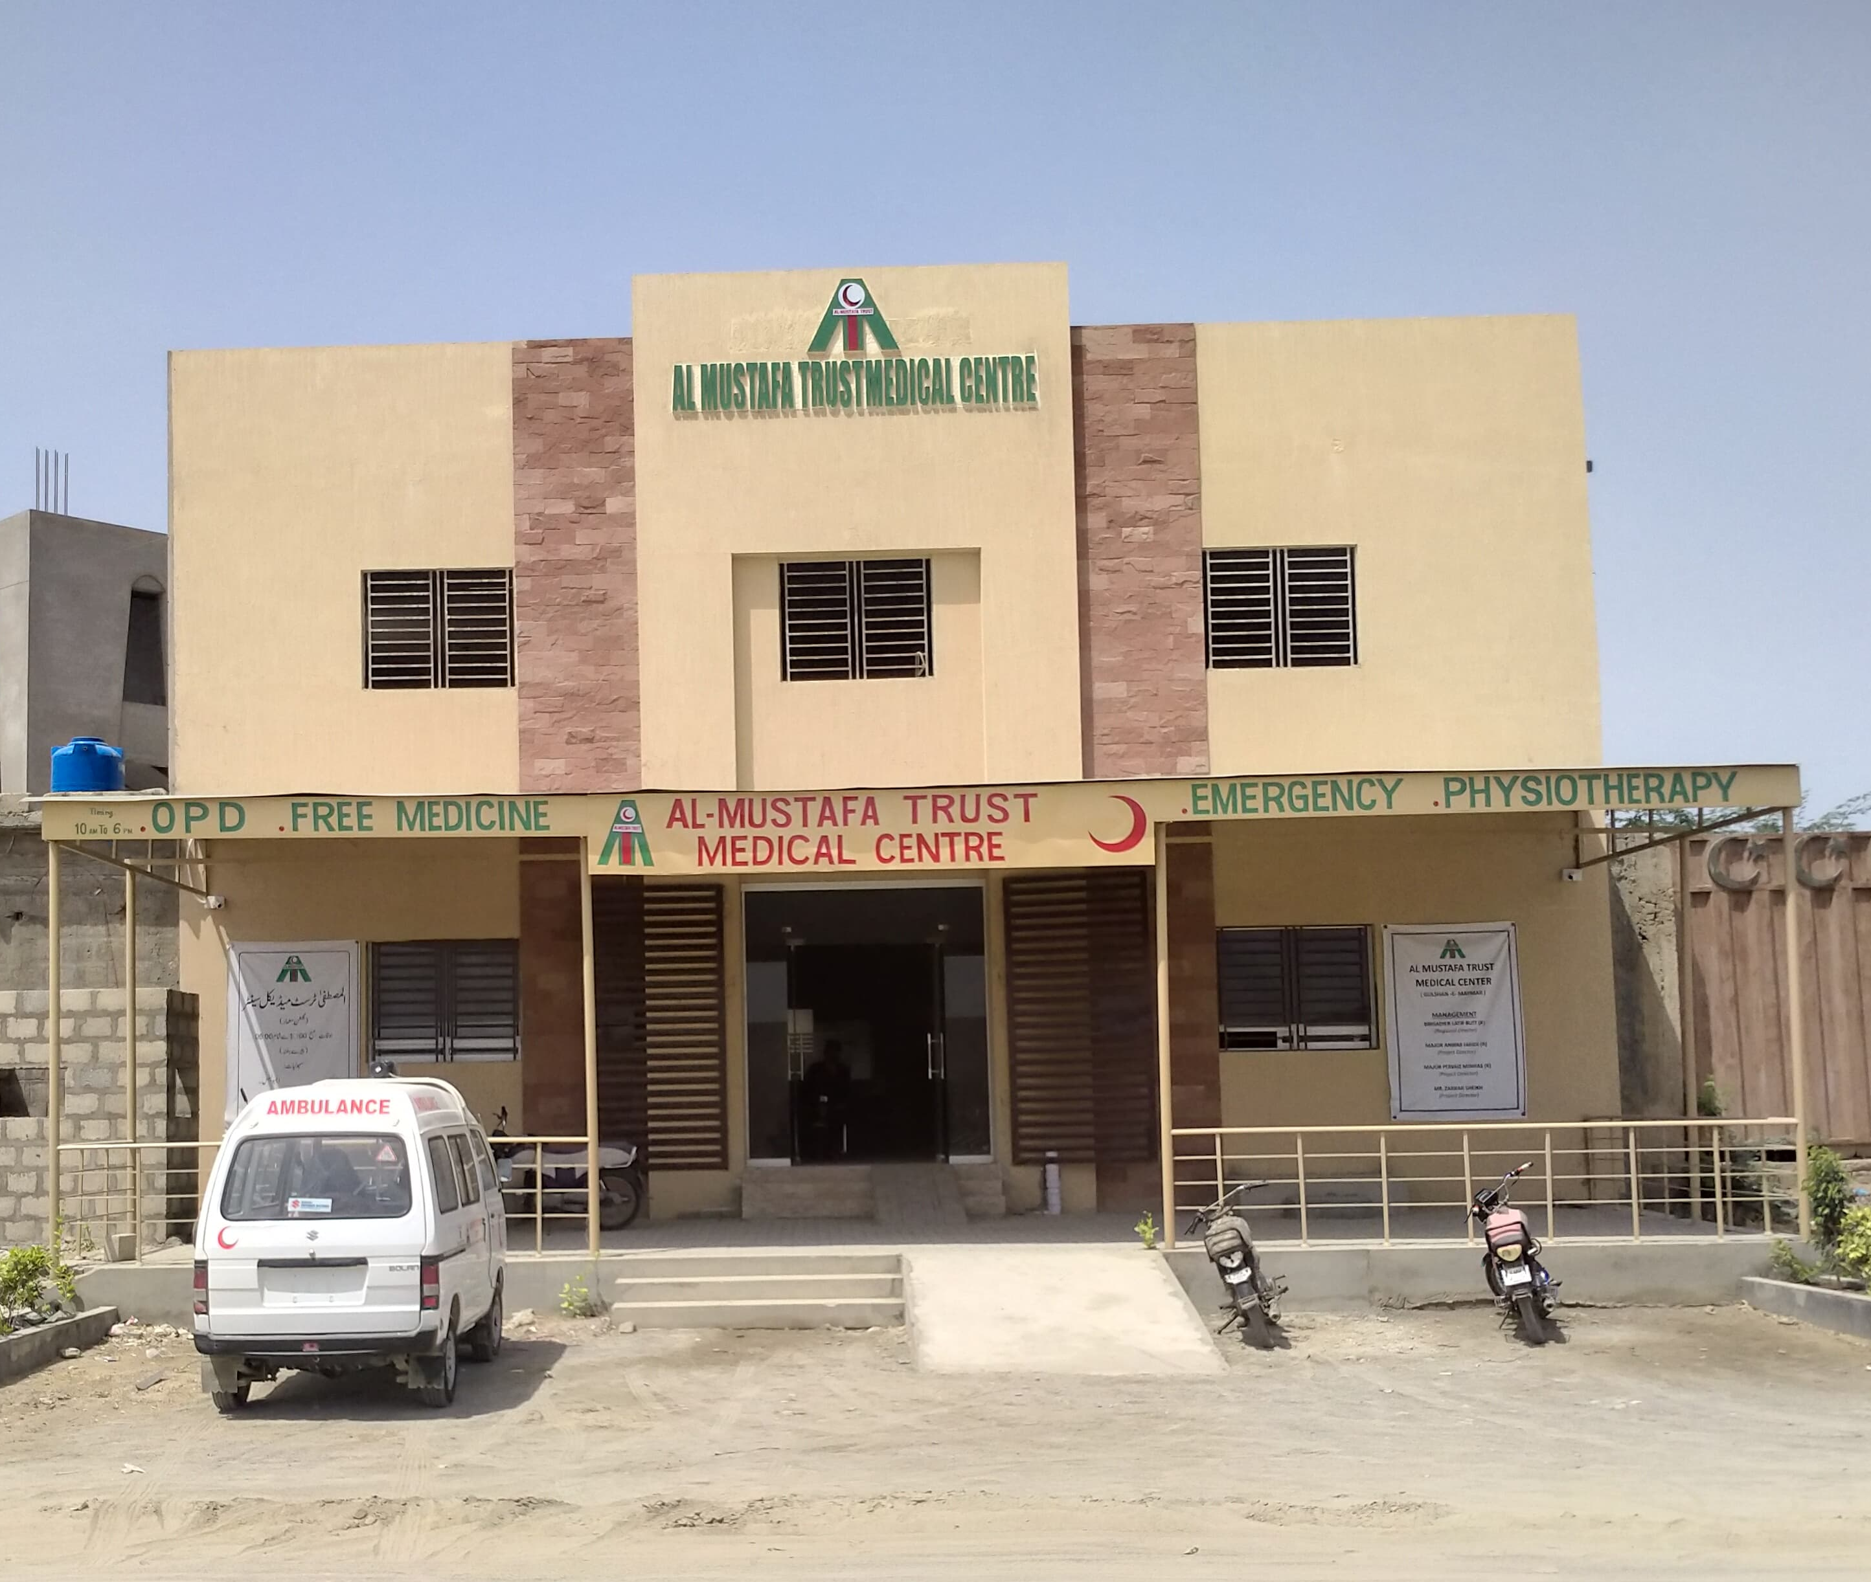
Gulshan-e-Maymar-Karachi
(29 Apr 2024)

Slide 33
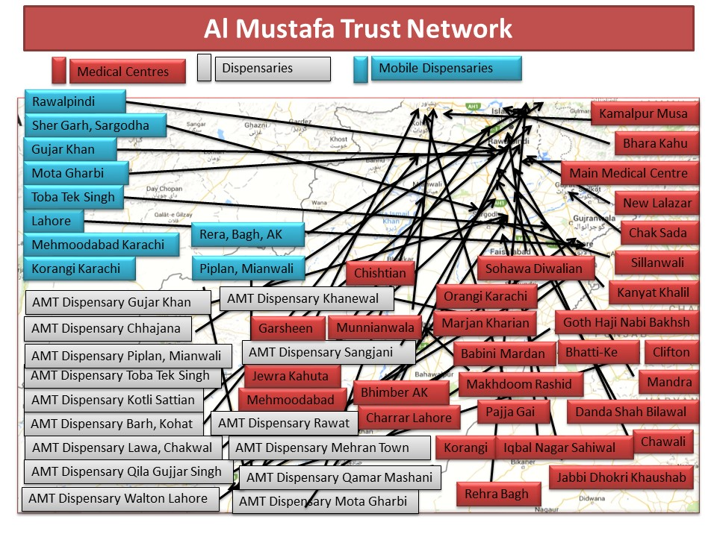
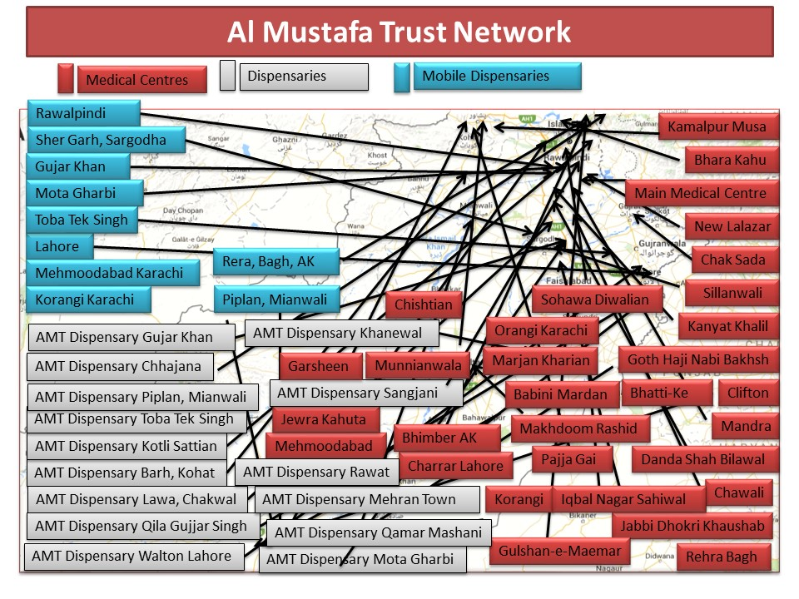
Al-Mustafa Trust Network
Al Mustafa Trust Network

Slide 34
Projects Under Development

Slide 35
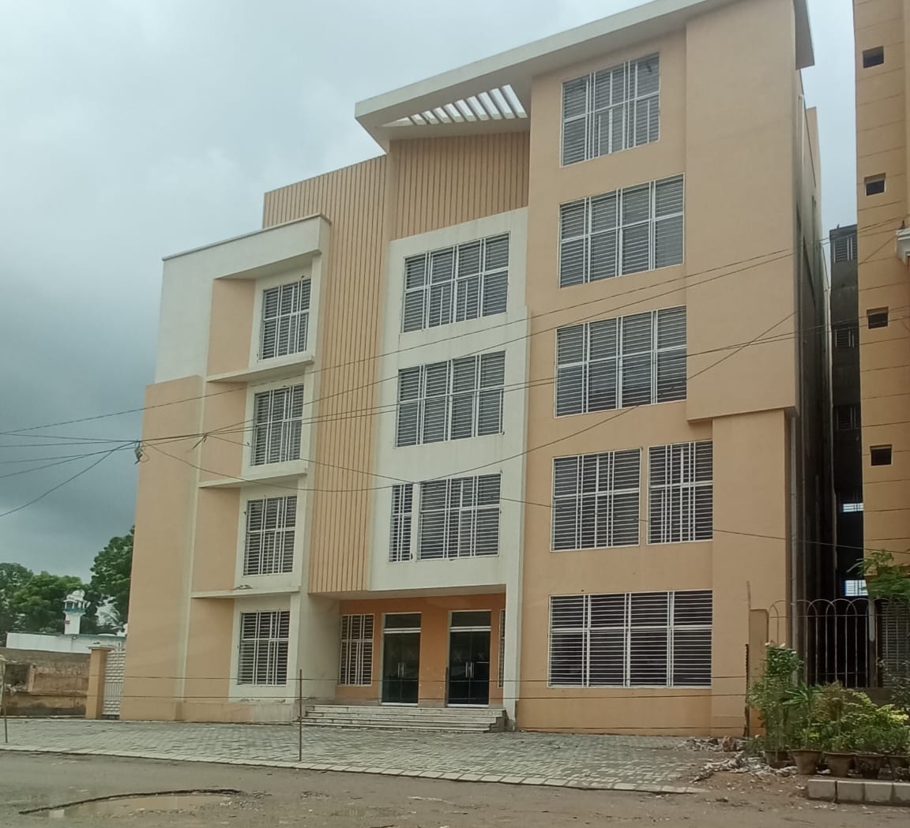
Green City, Malir-Karachi – by Mr Hanif Gohar

Slide 36
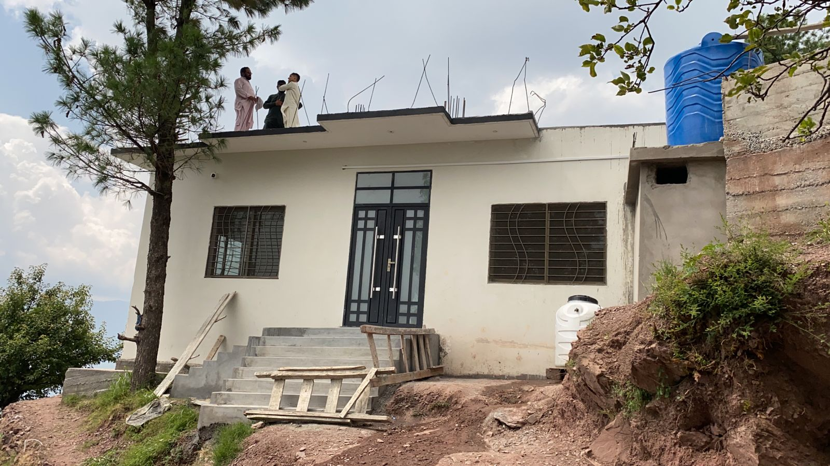
Chattian, Muzaffarabad
by Mr Mujeeb Qazi (USA)

Slide 37
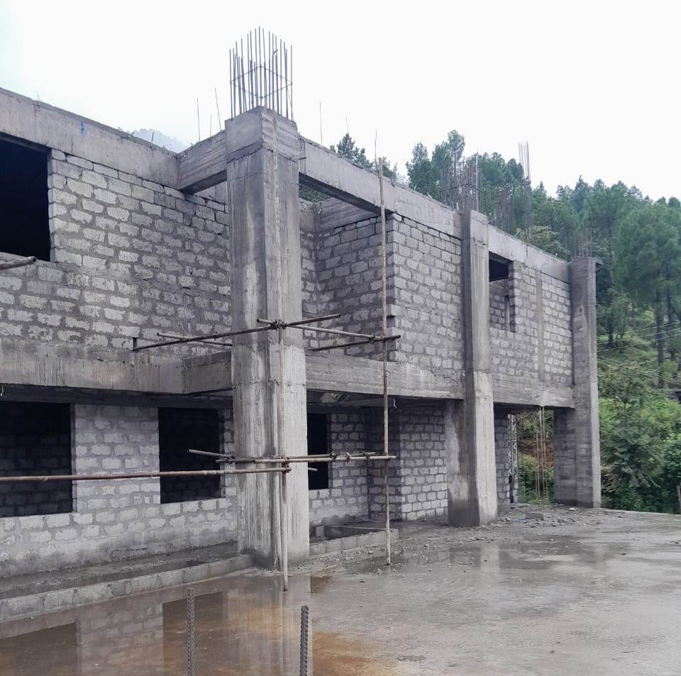
Ghail – Distt Muzaffarabad (AK) by Mr Zafar Iqbal Khan

Slide 38
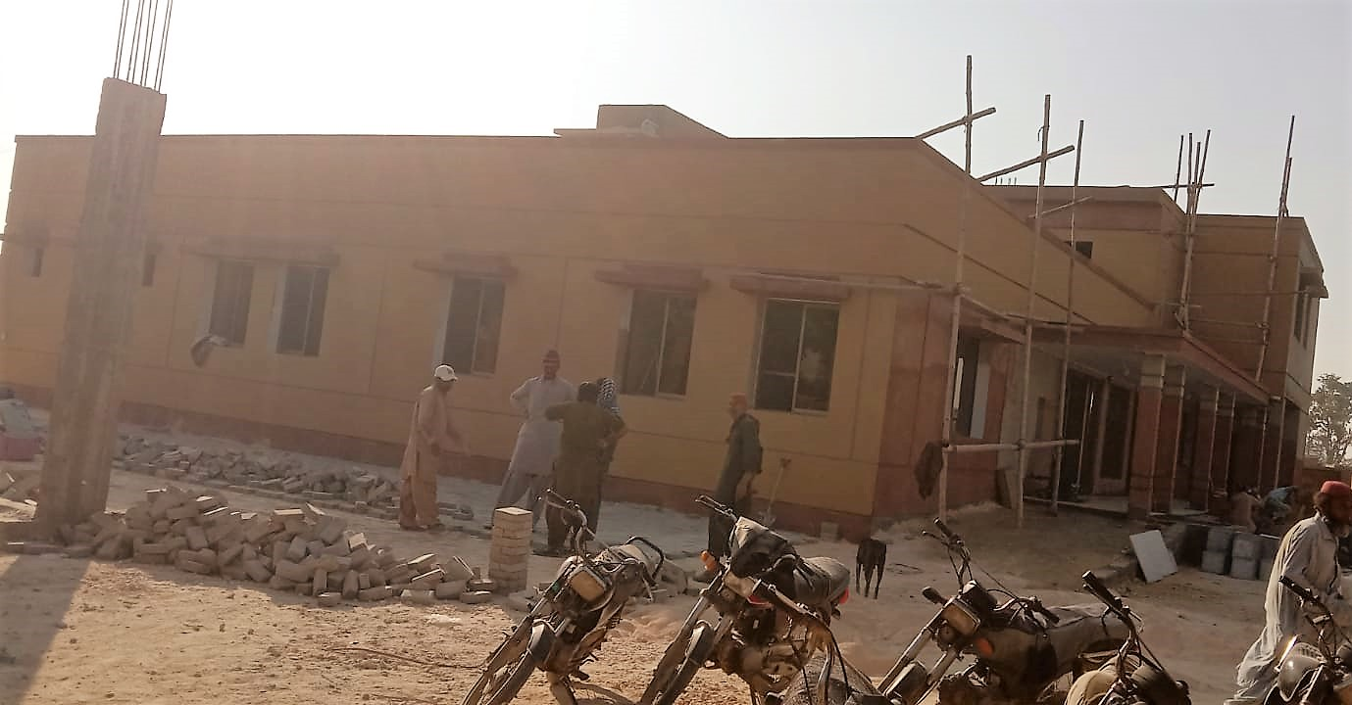


Matiari – Hyderabad – by Mr Tariq Zaidi

Slide 39
  Collaboration with
  Al Falah Bank Ltd

Slide 40



Asif Nagar, Qazi Ahmed District Nawabshah, Sindh Donated by Dr Asif Arain

Slide 41
Medical Centres Sponsored by
Al Falah Bank Ltd
Ghari Khairu, Usta Muhammad, Balochistan
Land 2 Kanal – Donated
    Construction Plan/Map & Diagram in process.
Khan Bela Rahimyar Khan, Punjab
Land 3 Kanal - Donated by Mr Jam Allah Ditta
Dera Ismail Khan, Khyber Pakhtunkhwa
Land 2 Kanal – Donated

Slide 42
Network of Al-Mustafa Trust
Urban Medical Centres: 09
Rural Medical Centres: 22
Dispensaries: 15
Under Construction 05
10* Mobile Clinics’ Stations: 63
Total Footprint: 114
46

Slide 43




AMT Network 2025-26
LEGEND
Medical Centre
Dispensary
Mobile Dispensary
Under Construction/
Consideration

Slide 44
  Additional Activities

Slide 45




Covid-19 Vaccination
Additional Activities
Distribution of Rations and Clothings

Slide 46





By Head Office & MMC Chaklala (for Babini, Mardan)
By Pajja Gai, Peshawar-KPK

Slide 47





By Sohawa Dewalian-Chakwal
By Rehra-Bagh, AK

Slide 48





By Head Office (for Quetta, Sukkur & Jaccobabad)
By MMC Lahore (for Southern Punjab)

Slide 49




Medical Camp at Matyari and Umerkot
Medical Camp at Jhuddo-Sindh and Pirmango

Slide 50




Medical Camp at Ghari Khairo
Medical Camp at Dalbandin, Baluchistan

Slide 51
Construction of Houses for
Flood Affectees

Slide 52


Slide 53


Situation before/after Construction

Slide 54




Construction of Houses
Rehabilitation of Flood Affectees

Slide 55


(Turkiye, 834 Blankets)
Aid to Muslim Breathern in Distress
(Ghaza/Palestine, Rs. 5 Million)

Slide 56
  Medical & Eye Camps
  (Regular Feature)

Slide 57




Rehra, Bagh-AK
Medical & Eye Camps (Regular Feature)
Sillanwali-Sargodha
Sohawa-Dewalian-Chakwal
Iqbal Nagar-Sahiwal

Slide 58




Kanyat Khalil-Gujar Khan
Medical & Eye Camps (Regular Feature)
Makhdoom Rashid-Multan
Barh-Kohat
Umerkot-Sindh

Slide 59


Medical & Eye Camps (Regular Feature)
Marjan-Kharian

Slide 60
Summary (Jan – Dec 2024)
Centre | Total Camp | Total Patients | Cataract
Dewalian | 25 | 6765 | 432
Makhdoom Rasheed Multan | 2 | 4691 | 509
Kanyat Khalil | 2 | 4225 | 19
New Dhokri Khushab | 1 | 335
Kot Jattan | 2 | 924 | 28
Marjan | 3 | 1353 | 31
Iqbal Nagar Sahiwal | 1 | 323 | 124
Chak Sada | 3 | 780 | 46
Rehra Bagh | 2 | 2494
Chajana Murree | 1 | 140
Total | 42 | 22,030 | 1,189

Slide 61
  Provision of Clean Water

Slide 62


Filtration/RO Plants

Slide 63

“Water for Life” Project in Interior Sindh

Slide 64




“Water for Life” Project in Interior Sindh

Slide 65
Financial Health

Slide 66
Financial Health of the Trust
Over the last three consecutive years, the Trust's expenses have risen by 35% to 40% annually, narrowing the Trust’s margin of safety.
This situation is becoming increasingly alarming due to:-
  Growing number of patients.
  Inflation, a sharp rise in the cost of medicine and equipment.
  Need for renovation of old equipment.
  Donors fatigue.
  Reserves depletion due to Covid-19.

Slide 67
Inflow & Out Flow 2020-2024

Slide 68
Projected Inflow & Out Flow 2025-2030

Slide 69

HOW YOU CAN HELP

Slide 70

Golden Words Engraved on the Grave Stone of Muhammad Ali Killay
“SERVICE TO OTHERS IS THE RENT YOU PAY FOR YOUR ROOM IN HEAVEN”

Slide 71




HOW YOU CAN HELP
Donations Exempted from Income Tax
Adopt a Signature Medical Centre (Yearly) 37-42 million
Adopt a Medical Centre (Yearly) 17-19 million
Static Dispensary (Yearly) 6.8 – 7.8 million
Mobile Dispensary (Yearly) 4.7 – 5.4 million

Slide 72




HOW YOU CAN HELP
Fabricated:
Suzuki/FAW 2.5 – 2.8 million
Toyota Hilux 8.6 – 10.2 million
Hyundai 4.8 million
Prince (Chinese) 3.5 million
Branded:
Toyota Hiace High Roof 14 – 16.5 million
Toyota Hiace low Roof 12.3 – 14.8 million

Slide 73



HOW YOU CAN HELP
Medical Equipment:
Lab Rs. 8.3 million
X-Ray Machine Processor Rs. 13 – 14.3 million
Eye Equipment Rs. 6 – 6.9 million
Dental Unit Rs. 1.9 – 2.2 million
Physiotherapy Equipment Rs. 5 – 6 million
Filtration Plant Rs. 1.5 – 1.8 million
RO Plant Rs. 1 million

Slide 74

HOW YOU CAN HELP
Donations Exempted from Income Tax
By donating your Zakat, Sadaqat or Charity to
Al-Mustafa Trust on a regular basis for the treatment of needy people.

Slide 75


Slide 76


Slide 79
Expenditure Breakdown
Expenses | Subtotal | Grand Total | %
Program Expenses
Salaries Exp-ParaMedics | 176,557,893 |  | 30%
Medical/Ambu Exp | 272,206,830 |  | 47%
Total |  | 488,764,723 | 77%
Admin Expenses
Salaries Exp-Management | 4,325,700 |  | 0.7%
Salaries Exp-Admin staff | 59,883,962 |  | 10%
Trust Overhead Expenses (i.e Vehicles Repair, Fuel,Repairs & Maintenance, Travelling etc) | 68,056,152 |  | 12%
Total |  | 132,265,814 | 23%
Total Expenditure |  | 581,030,537 | 100%
Salaries Expenses
Salaries Exp-ParaMedics |  | 176,557,893 | 73%
Salaries Exp-Management |  | 4,325,700 | 2%
Salaries Exp-Admin staff |  | 59,883,962 | 25%
Total |  | 240,767,555 | 100%

Slide 80
Financial Health of the Trust
The gap between income and expenses is on the increase:-
  Rs 35 million in 2022.
  Rs 41 million in 2023.
  Rs 49 million in 2024.
  Projected for 2025 to exceed Rs 60 million per month.
Manpower
Medical | Paramedical | Administrative | Total
138 | 237 | 245 | 620

Slide 81
Financial Health of the Trust
Over the last three consecutive years, the Trust's expenses have risen by approximately 35% to 40% narrowing the Trust’s margin of safety.
This situation is becoming increasingly alarming due to:-
  Growing number of patients.
  Inflation, a sharp rise in the cost of medicine and equipment.
  These pressures underscore the need for enhanced financial management and resource mobilization.

Slide 82
Financial Health of the Trust

Slide 83
Flood Relief Summary
Items | Baluchistan (Million) | Punjab (Million) | KPK (Million) | Sind (Million) | Total (Million)
Medicines | 4.8 | 1.03 | 1.12 | 7.7 | 14.65
Rations | 1.4 | 0.98 |  | 2.4 | 4.78
Cloths | 1.6 |  |  |  | 1.6
Houses |  |  |  | 9.2 | 9.2
Total | 7.8 | 2.01 | 1.12 | 19.3 | 30.23

Slide 84
Comparative Data of Services
2015-2024
Medical Centers | Total Patients | Lab Tests | Ultra Sound | X-Ray | Cataract Operation | Physio Therapy | Dental Cases | ECG
Beneficiaries in 2015 | 266273 | 40452 | 5853 | 5589 | 464 | 5970 | 6380 | 1150
Beneficiaries in 2016 | 365922 | 48995 | 5904 | 5545 | 370 | 7306 | 2898 | 1442
Beneficiaries in 2017 | 542455 | 71637 | 9695 | 6204 | 311 | 10252 | 9374 | 1694
Beneficiaries in 2018 | 677986 | 88718 | 13896 | 7132 | 726 | 9918 | 12290 | 2019
Beneficiaries in 2019 | 942605 | 88460 | 11131 | 6509 | 4403 | 18781 | 19489 | 1449
Beneficiaries in 2020 | 816591 | 64519 | 9070 | 4412 | 6634 | 19219 | 16136 | 1592
Beneficiaries in 2021 | 1057107 | 81445 | 13687 | 4959 | 2087 | 25690 | 24175 | 1355
Beneficiaries in 2022 | 1348019 | 99177 | 15449 | 5592 | 1677 | 32356 | 32851 | 1778
Beneficiaries in 2023 | 1590794 | 103954 | 22074 | 7120 | 2159 | 35669 | 37344 | 2434
Beneficiaries in 2024 | 1856077 | 129867 | 37944 | 32911 | 23988 | 7957 | 2845 | 1241
G.Total | 9463829 | 817224 | 144703 | 85973 | 42819 | 173118 | 163782 | 16154

Slide 85
Organization of the Trust
Council of Trustees
Board of Directors
Executive Committee
Board of Management
Project Management Committee

Slide 86
Medical Centres Sponsored by
Al Falah Bank Ltd
Facilities
Gen OPD (Male & Female Doctors).
Ambulance Facility.
Lab Test Facility.
Ultrasound Facility.
Trauma Center with Oxygen Facility in Emergency.

Slide 87
Computerization of the Trust
S# | Branch Name | Deployment Date | S# | Branch Name | Deployment Date
1 | Mehmoodabad | 2019 | 13 | Faisalabad | May 2023
2 | Korangi | March 2020 | 14 | Multan | August 2023
3 | Chaklala scheme III | April 2020 | 15 | Wazirabad | September 2023
4 | Clifton | December 2020 | 16 | Jewera Kahuta | October 2023
5 | Orangi Town | April 2021 | 17 | Chishtian | December 2023
6 | Sillanwali | May 2021 | 18 | Iqbal Nagar | March 2024
7 | Khawaja Co Chowk | November 2021 | 19 | Gulshan-E-Maymar | 28 April 2024
8 | Mehran Town | April 2022 | 20 | Kanyat Khalil | (In process)
9 | DHA Lahore | May 2022 | 21 | Khanewal | (In process)
10 | Walton | June 2022 | 22 | Pajja gai Peshawar | (In process)
11 | Qila Gujjar Singh | September 2022 | 23 | Babini Mardan | (In process)
12 | Umerkot | November 2022

Slide 88
Financial Health of the Trust
Anticipated Gap – Over 60 Million

Slide 89
Comparison Of Fundraising Costs
This is comparison with Islamic Relief and Cancer Research. The former being the largest Islamic Charity and latter is the largest overall UK Charity.
Al-Mustafa Charitable Trusts 2.5%
Cancer Research 14.8%
Islamic Relief 13.1%

Slide 90
Management Costs Of Charities in UK
Median Cost of 100 highest paid charity positions is £165k P.A.
Islamic relief published figures for 2016 shows their 2 employees were paid in excess of £60,000 P.A. The exact figure remains undisclosed. These figures are taken from https://www.civilsociety.co.uk/news/increase-in-voluntary-donations-leads-to-record-income-for-islamic-relief-worldwide.html#sthash.mkz6ydFE.dpuf

Slide 91
Management Costs Of Charities in UK
All our Senior Management including Regional and Project Directors are volunteers.
In addition many Senior Doctors and local volunteers offer their services to medical centers close to their residences, Alhamdolillah.

